Slide 1
Cloud Computing
SEWP ZG527

Slide 2


IaaS
Really, what is iaas???
Notes:
RL 3.1

Slide 3
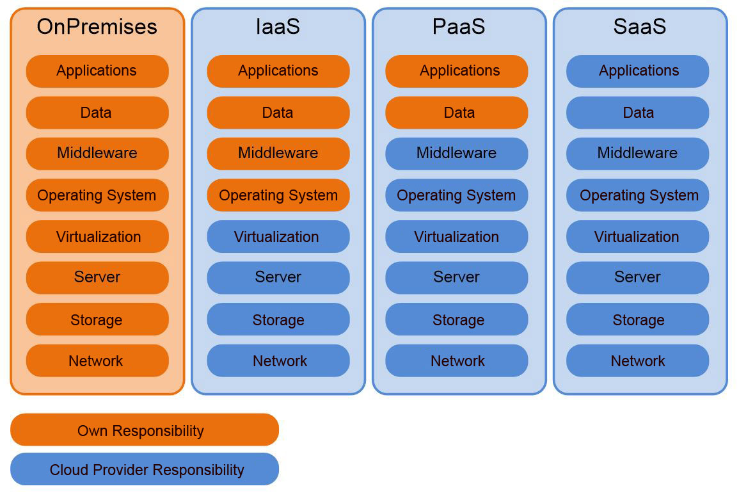
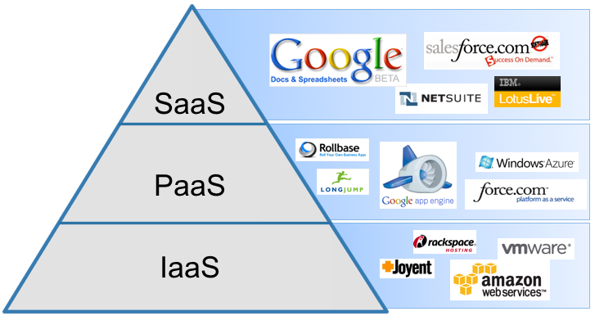
heard of 3 models of Cloud Computing?
Yes, Yes, IaaS, PaaS and SaaS

Slide 4
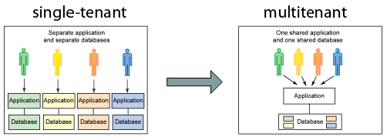
Key concepts of IaaS
Cloudbursting: The process of off-loading tasks to the cloud during times when the most compute resources are needed
Multi-tenant computing
Resource pooling: Pooling is a resource management term that refers to the grouping together of resources (compute(cpu), network(bandwidth), storage) for the purposes of maximizing advantage and/or minimizing risk to the users
Hypervisor

Slide 5
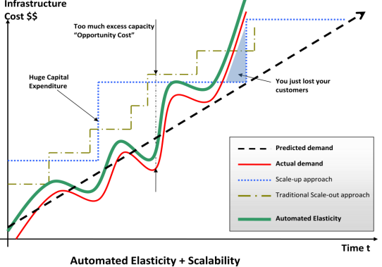
Two primary facets that make IaaS special
Elasticity:
Wikipedia: “In cloud computing, elasticity is defined as the degree to which a system (or a particular cloud layer) autonomously adapts its capacity to workload over time”
OR simply put “Ability of a system to expand or contract its dedicated resources to meet the demand”
&
Virtualization

Slide 6
The value of IaaS
For businesses, the greatest value of IaaS is through a concept known as cloudbursting—the process of off-loading tasks to the cloud during times when the most compute resources are needed.
To take advantage of IaaS in this capacity, IT departments must be able to build and implement the software that handles the ability to re-allocate processes to an IaaS cloud.
There are four important considerations to build and implement software that can manage such reallocation processes.

Slide 7
4 considerations:
Developing for a specific vendor's proprietary IaaS could prove to be a costly mistake
The complexity of well-written resource allocation software is significant and do not come cheap
What will you be sending off to be processed in the cloud? Sending data such as personal identities, financial information, and health care data put an organization's compliance at risk
Understand the dangers of shipping off processes that are critical to the day-to-day operation of the business.
http://www.ibm.com/developerworks/cloud/library/cl-cloudservices1iaas/

Slide 8
